Slide 1


RNA-Seq Workshop: Genome-Guided and Genome-Free Transcript Reconstruction and Analysis Using RNA-Seq
Brian Haas
Broad Institute
Content updated Oct, 2016
Notes:
I: Lecture ~ 90 mins
--------------------------
1) Generating RNA-Seq data, problems, errors, what biological information is really being captured
Quality filtering of RNA-Seq data, removal of PCR duplicates (appropriate for longer fragment RNA-Seq data)
2) Conceptual differences between de novo transcript-assembly and genome-guided
Include an intro to what transcript assembly means, why we need to do it. What we can learn from it. How it's different from Sanger ESTs (high abundance, but very short reads)
3) Transcript Assembly without a reference genome
Read Normalization, approaches, algorithms, recommendations
Trinity, overview, steps in code (inchworm, chrysalis, butterfly), some algorithm details for each of the steps
Trinity command line details, recommended options, hardware considerations, expected runtime, memory.
Analyzing the transcripts (e.g. differential expression: RSEM, DESeq, other tools)
4) Transcript Assembly with a reference genome
(see http://www.nature.com/nprot/journal/v7/n3/full/nprot.2012.016.html)
Read pre-processing: filtering etc
Tuxedo (Tophat, Cufflinks, Cuffmerge, Cuffdiff, CummerBund) overview, algorithm details (especially bowtie2)
Command line details, recommended options, hardware time and memory considerations.
GFF file format for handling output data, gffread utility
5) General applications of transcript assemblies
Using the transcripts to annotate genomes
Recap on studying differential gene expression
II: Workshop ~ 2-2.5 hrs
---------------------------------
1) With a test dataset limited to a small region of a genome, assemble transcripts with both Trinity and Tuxedo to assemble transcripts from at least two conditions.
2) Look for evidence of differential expression in the transcripts that were just assembled.
3) Consider making plots with e.g. CummerBund or R or other tools.

Slide 2
RNA-Seq Workshop Overview
Genome-based and genome-free transcript reconstruction from RNA-Seq
Running the Tuxedo and Trinity software and visualizing the results.
Basic principles of transcript abundance estimation
Basic principles of differential expression analysis
Analysis frameworks included in Tuxedo and Trinity

Slide 3

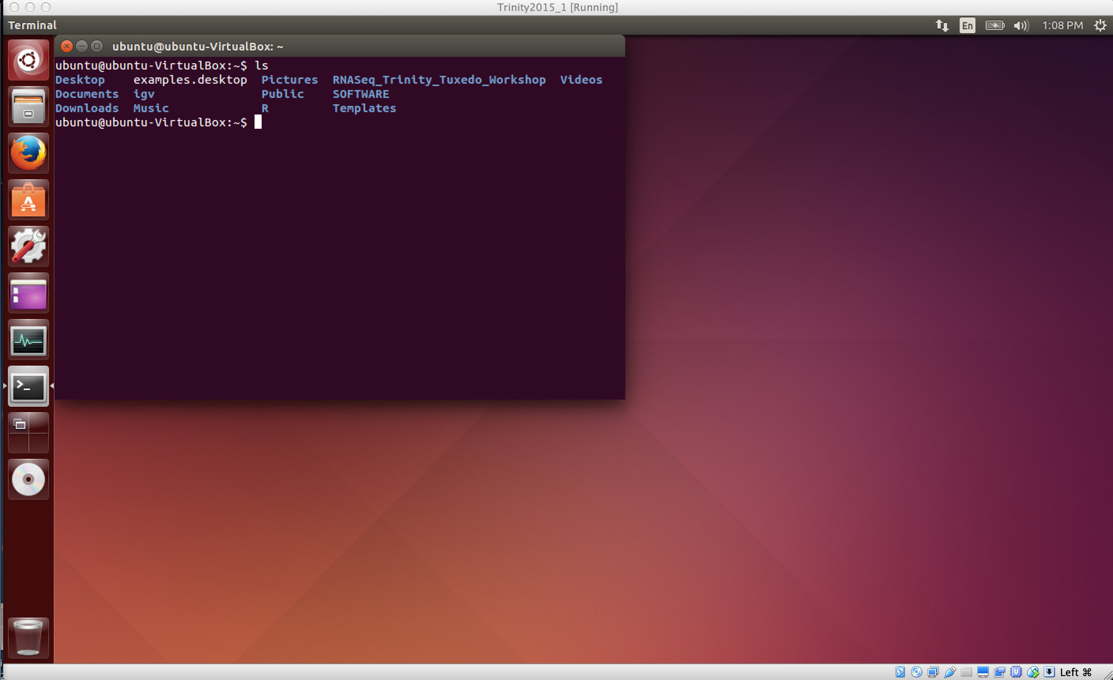
Trinity RNA-Seq Workshop Website
https://github.com/trinityrnaseq/RNASeq_Trinity_Tuxedo_Workshop/
(click the Wiki link at right)
Includes:
Installation guide for VirtualBox and the workshop VM
Ubuntu linux running on Mac or PC via VirtualBox software.
Easy installation!
VM comes installed with workshop data and software.
Self-guided tutorials for running
Genome-guided RNA-Seq analysis using Tuxedo
Genome-free RNA-Seq analysis using Trinity

Slide 4
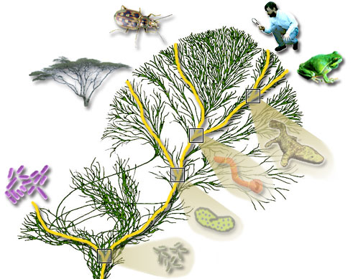
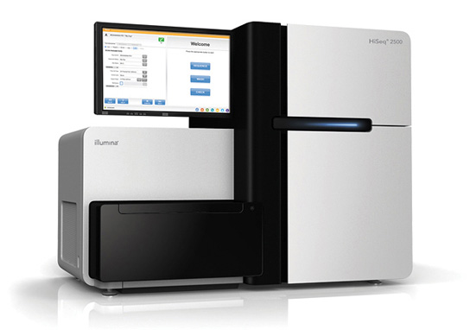
RNA-Seq Empowers Transcriptome Studies
Extract RNA, convert to cDNA
Next-gen Sequencer
(pick your favorite)
Notes:
RNA-Seq is a powerful technology for identifying genes and profiling gene expression in any living organism.
----
It just requires that you can collect RNA from your sample of interest.
----
Sequencing the transcriptome on your favorite next-gen sequencer will often generate millions of reads, but the reads tend to be much shorter than the original transcript.
----
Some of the key challenges in analyzing these data include inferring the full-length transcript sequence from which the shorter reads were derived, and to accurately estimate the transcript expression levels.

Slide 5
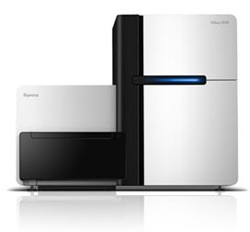
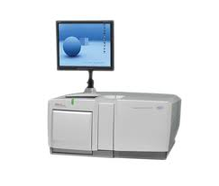
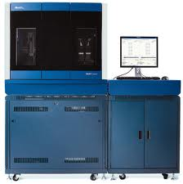
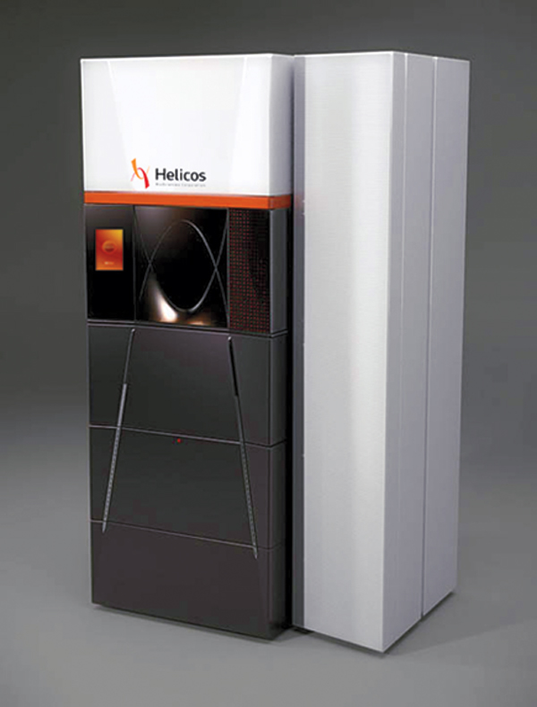
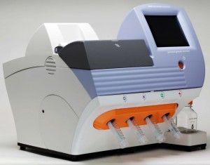
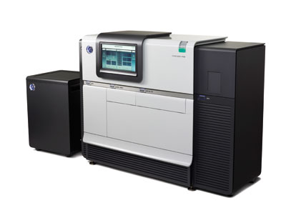
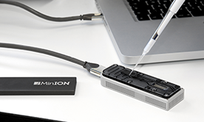
Generating RNA-Seq: How to Choose?
Many different instruments hit the scene in the last decade
Illumina
454
SOLiD
Helicos
Ion Torrent
Pacific Biosciences
Oxford Nanopore
Slide courtesy of Joshua Levin, Broad Institute.

Slide 6
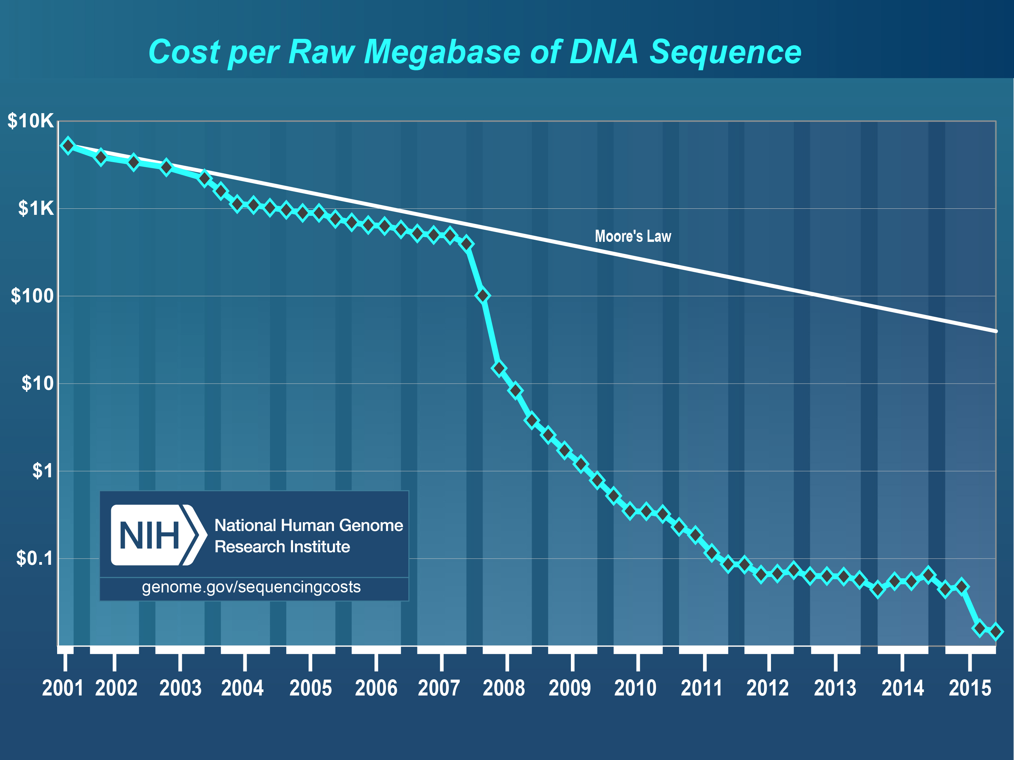
From https://www.genome.gov/sequencingcostsdata/

Slide 7
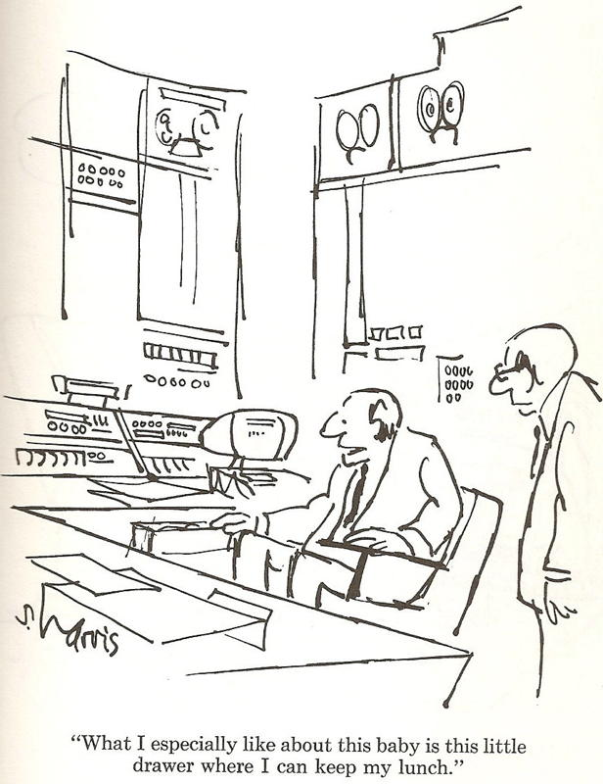
RNA-Seq: How to Choose?
Illumina
454
SOLiD
Helicos
Ion Torrent
Pacific Biosciences
Oxford Nanopore
Slide courtesy of Joshua Levin, Broad Institute.

Slide 8
Generating RNA-Seq: How to Choose?
Popular choices for RNA-Seq today
Illumina
454
SOLiD
Helicos
Ion Torrent
Pacific Biosciences
Oxford Nanopore

Slide 9
Generating RNA-Seq: How to Choose?
Popular choices for RNA-Seq today
[Current RNA-Seq workhorse]
[Newly emerging technology for full-length single molecule sequencing]
Illumina
454
SOLiD
Helicos
[Full-length single molecule sequencing]
Ion Torrent
Pacific Biosciences
Oxford Nanopore

Slide 10
RNA-Seq: How do we make cDNA?
Prime with Random Hexamers (R6)
mRNA
5’
3’
R₆
R₆
R₆
Reverse transcriptase
First strand synthesis
R₆
R₆
R₆
RNase H
DNA polymerase
DNA Ligase
Second strand synthesis
Illumina cDNA Library
Slide courtesy of Joshua Levin, Broad Institute.

Slide 11
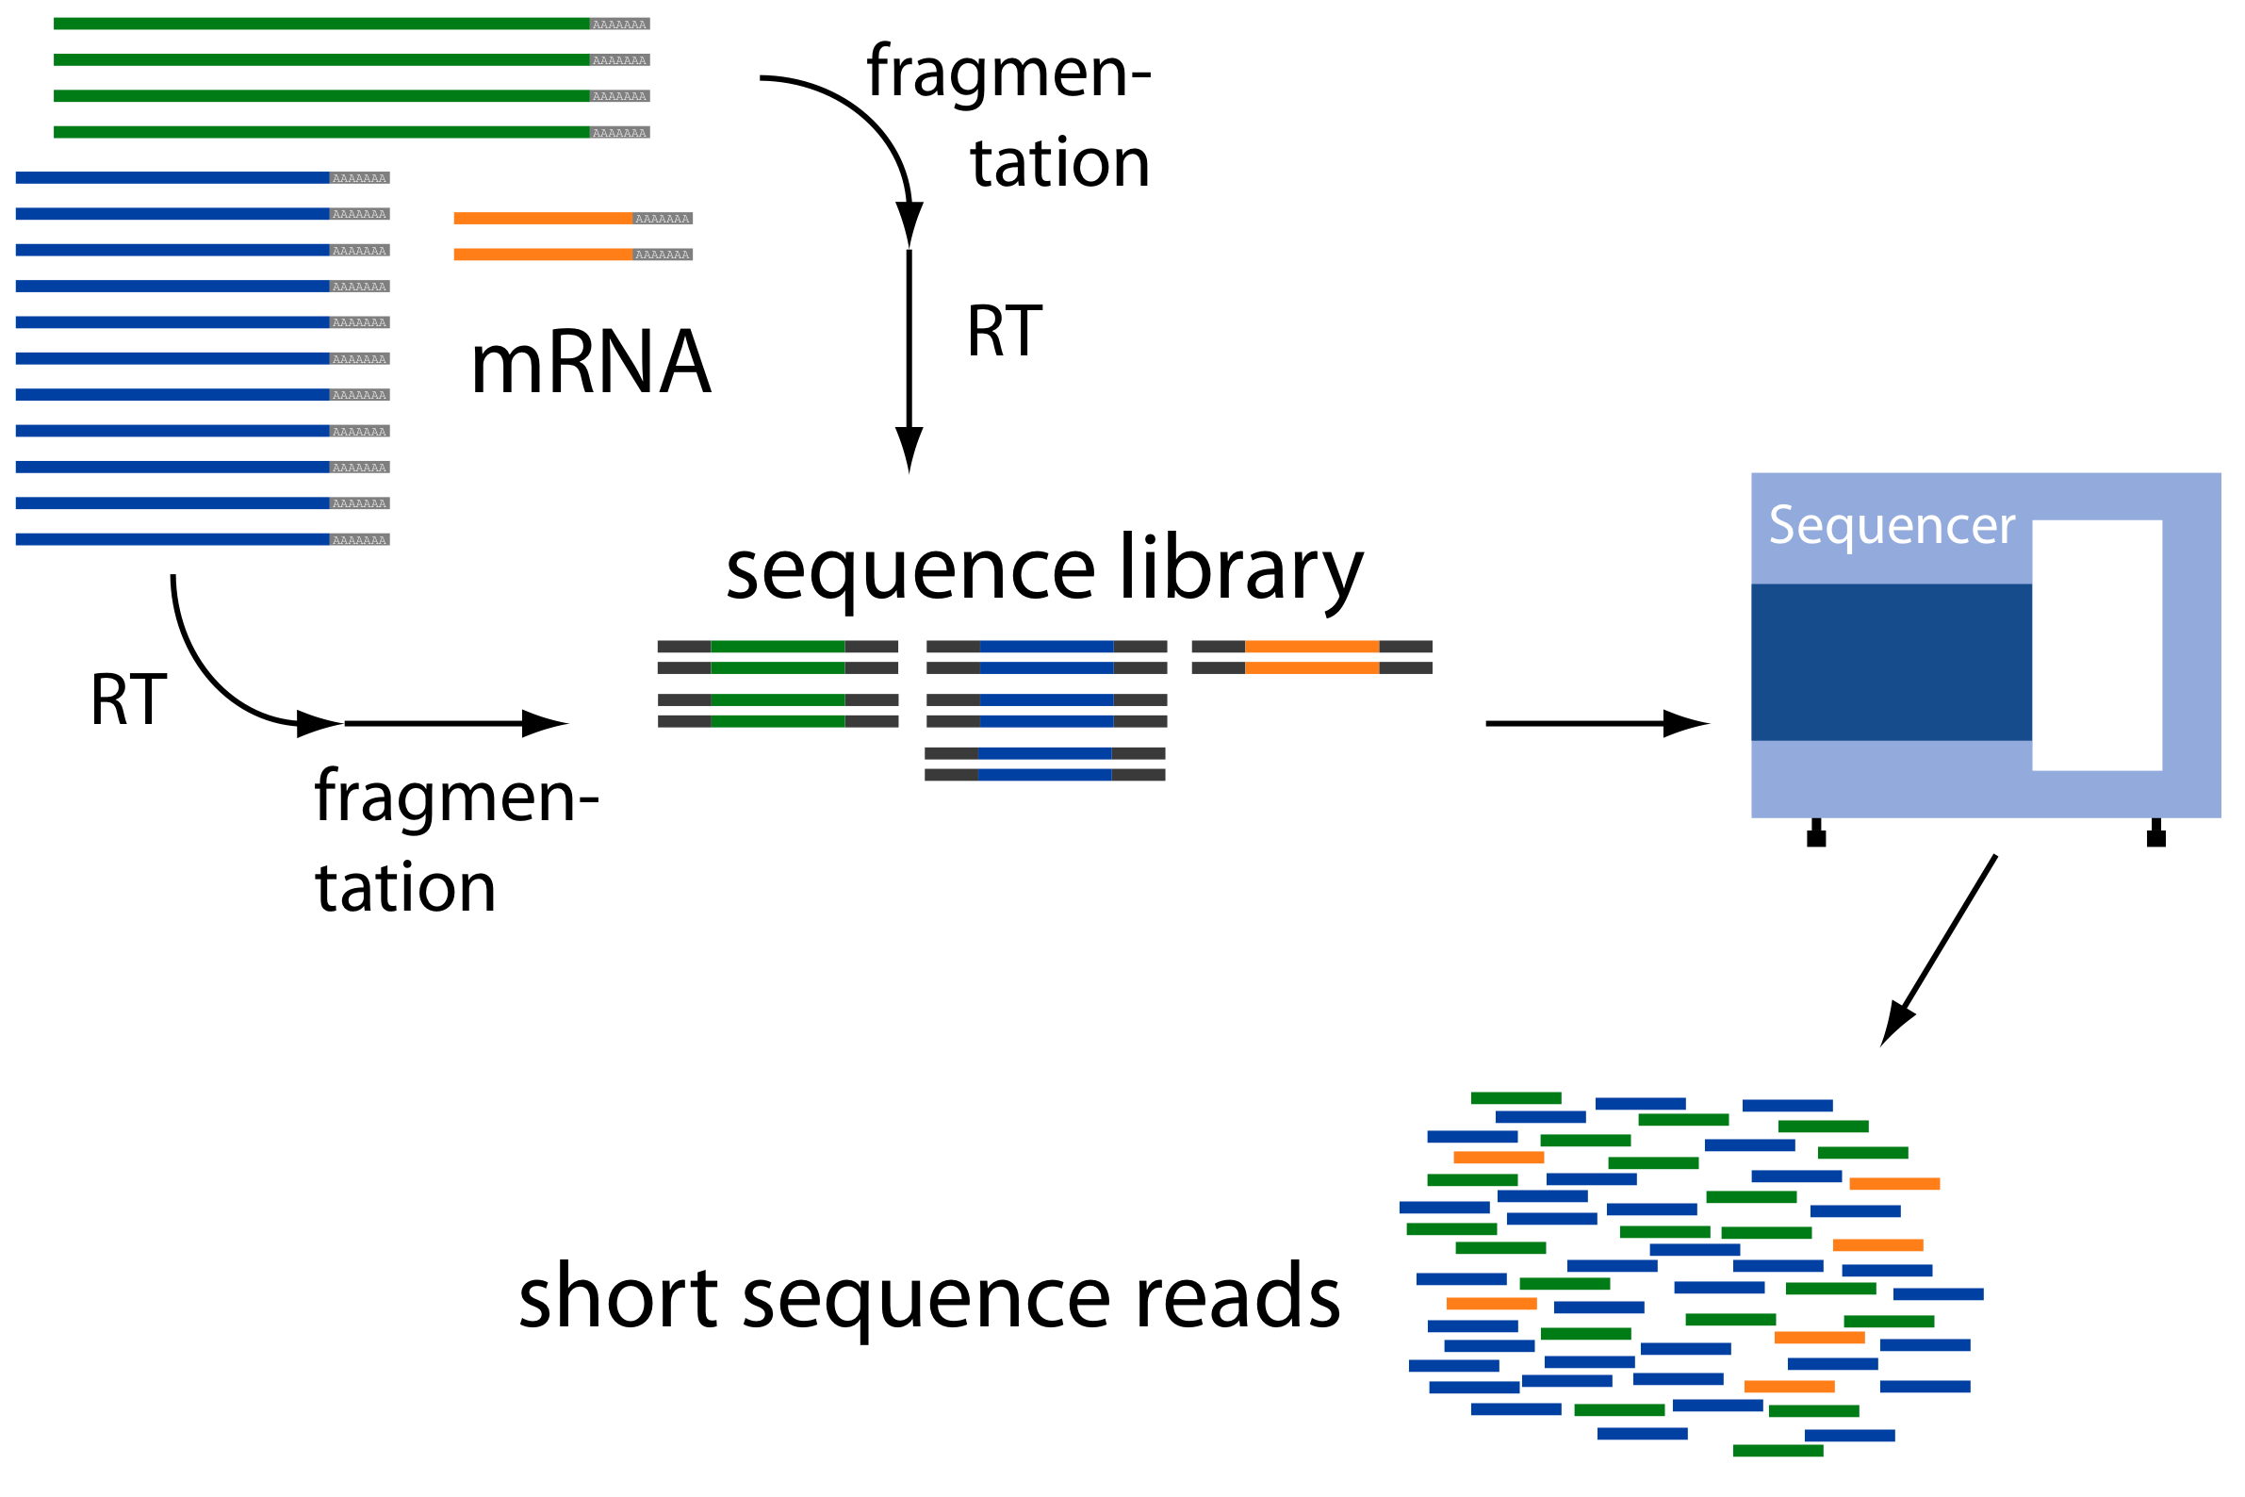
Overview of RNA-Seq
From: http://www2.fml.tuebingen.mpg.de/raetsch/members/research/transcriptomics.html

Slide 12
Common Data Formats for RNA-Seq
FASTA format:
>61DFRAAXX100204:1:100:10494:3070/1
AAACAACAGGGCACATTGTCACTCTTGTATTTGAAAAACACTTTCCGGCCAT
FASTQ format:
@61DFRAAXX100204:1:100:10494:3070/1
AAACAACAGGGCACATTGTCACTCTTGTATTTGAAAAACACTTTCCGGCCAT
+
ACCCCCCCCCCCCCCCCCCCCCCCCCCCCCBC?CCCCCCCCC@@CACCCCCA
Read
Quality values
AsciiEncodedQual(x) = -10 * log10(Pwrong(x)) + 33
AsciiEncodedQual (‘C’) = 64
So, Pwrong(‘C’) = 10^( (64-33/ (-10) ) = 10^-3.4 = 0.0004

Slide 13
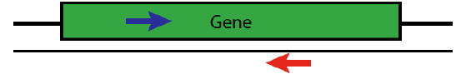
Paired-end Sequences
Two FastQ files, read name indicates left (/1) or right (/2) read of paired-end
@61DFRAAXX100204:1:100:10494:3070/1
AAACAACAGGGCACATTGTCACTCTTGTATTTGAAAAACACTTTCCGGCCAT
+
ACCCCCCCCCCCCCCCCCCCCCCCCCCCCCBC?CCCCCCCCC@@CACCCCCA
@61DFRAAXX100204:1:100:10494:3070/2
CTCAAATGGTTAATTCTCAGGCTGCAAATATTCGTTCAGGATGGAAGAACA
+
C<CCCCCCCACCCCCCCCCCCCCCCCCCCCCCCCCCCCCCCCCCCCCCBCCCC

Slide 14
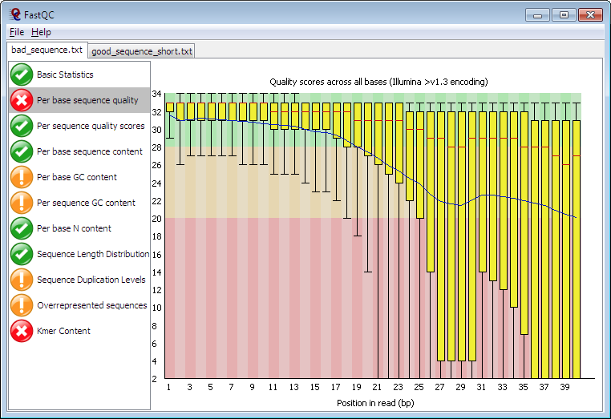
Read Quality Assessment
From: http://www.bioinformatics.babraham.ac.uk/projects/fastqc/

Slide 15
Overview of RNA-Seq
Reconstruct original full-length transcripts
From: http://www2.fml.tuebingen.mpg.de/raetsch/members/research/transcriptomics.html

Slide 16
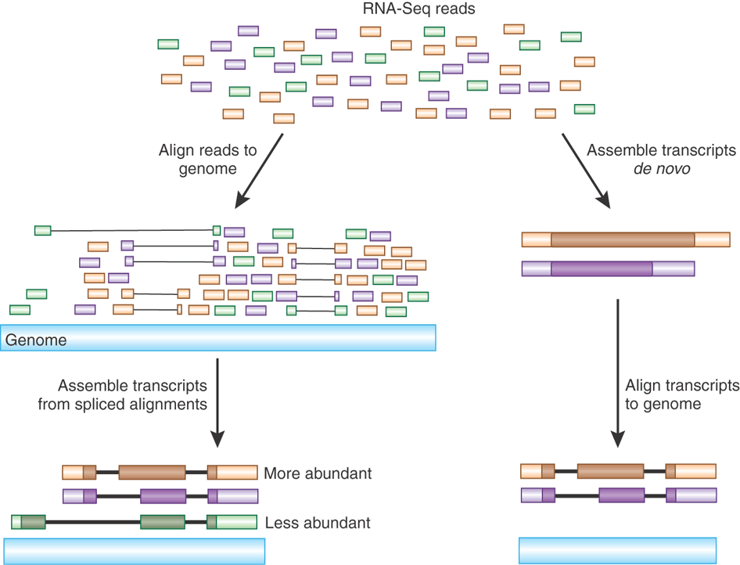
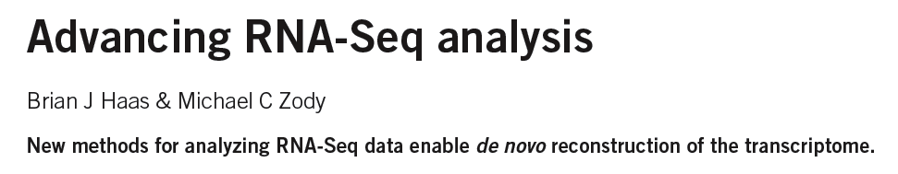
Transcript Reconstruction from RNA-Seq Reads
Nature Biotech, 2010
Notes:
One of the primary goals in RNA-Seq studies is to reconstruct the transcripts from which the short reads were derived, and transcript reconstruction is often a prerequisite to downstream studies such as genome annotation or diifferential expression analysis.
Two general strategies have been explored for reconstructing transcripts from RNA-Seq reads.

Slide 17
Transcript Reconstruction from RNA-Seq Reads
TopHat
Notes:
One strategy requires having a reference genome and involves first aligning reads to the genome using a spliced aligner.

Slide 18
Transcript Reconstruction from RNA-Seq Reads
TopHat
Cufflinks
Notes:
Then, the alignments, instead of the original reads, are assembled into transcript structures.

Slide 19

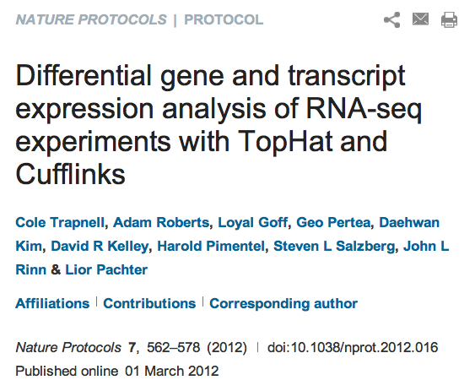

Transcript Reconstruction from RNA-Seq Reads
Trinity
TopHat
The Tuxedo Suite:
End-to-end Genome-based RNA-Seq Analysis Software Package
Cufflinks
GMAP
Notes:
Then, if a genome sequence is available, the assembled transcripts can be aligned to the genome to reveal individual introns and exons.

Slide 20
Transcript Reconstruction from RNA-Seq Reads
TopHat
Trinity
Cufflinks
Notes:
An alternative strategy doesn’t require a reference genome and involves assembling the read sequences directly.

Slide 21
Transcript Reconstruction from RNA-Seq Reads
TopHat
Trinity
Cufflinks
GMAP
Notes:
Then, if a genome sequence is available, the assembled transcripts can be aligned to the genome to reveal individual introns and exons.

Slide 22

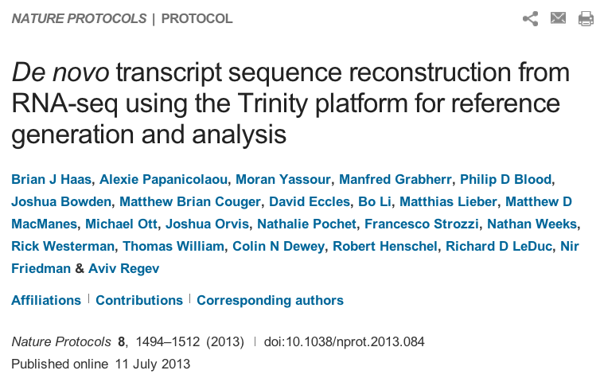
Transcript Reconstruction from RNA-Seq Reads
End-to-end Transcriptome-based RNA-Seq Analysis Software Package
Trinity
GMAP
Notes:
Trinity is a software tool that I helped develop, and which we published last year in Nature Biotechnology.
In this talk, I’ll describe how Trinity works, and describe some of the applications that we aim to support.

Slide 23
Transcript Reconstruction from RNA-Seq Reads
Many tools to choose among:
Trinity
Oases
SoapDenovoTrans
AbyssTrans
IDBA-Tran
Shannon
BinPacker
Bridger
…
TopHat STAR HISAT
GSNAP
…
GMAP
BLAT
AAT
Spidey
Sim4
…
Cufflinks
Stringtie
IsoLasso
Bayesembler
Trip
Traph
CEM
TransComb
…
Notes:
Then, if a genome sequence is available, the assembled transcripts can be aligned to the genome to reveal individual introns and exons.

Slide 24


Overview of the Tuxedo Software Suite
Bowtie (fast short-read alignment)
TopHat (spliced short-read alignment)
Cufflinks (transcript reconstruction from alignments)
Cuffdiff (differential expression analysis)
CummeRbund (visualization & analysis)

Slide 25
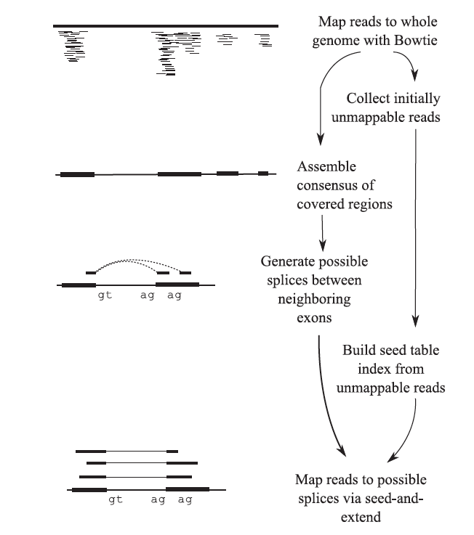
The TopHat Pipeline
From Trapnell, Pachter, & Salzberg. Bioinformatics. 2009
Notes:
The initial step of Tuxedo involving the use of Bowtie and Tophat to generate spliced alignments of short reads to the genome is depicted here.

Slide 26
Alignments are reported in a compact representation: SAM format
0 61G9EAAXX100520:5:100:10095:16477
1 83
2 chr1
3 51986
4 38
5 46M
6 =
7 51789
8 -264
9 CCCAAACAAGCCGAACTAGCTGATTTGGCTCGTAAAGACCCGGAAA
10 ###CB?=ADDBCBCDEEFFDEFFFDEFFGDBEFGEDGCFGFGGGGG
11 MD:Z:67
12 NH:i:1
13 HI:i:1
14 NM:i:0
15 SM:i:38
16 XQ:i:40
17 X2:i:0
SAM format specification: http://samtools.sourceforge.net/SAM1.pdf

Slide 27
Alignments are reported in a compact representation: SAM format
(read name)
0 61G9EAAXX100520:5:100:10095:16477
1 83
2 chr1
3 51986
4 38
5 46M
6 =
7 51789
8 -264
9 CCCAAACAAGCCGAACTAGCTGATTTGGCTCGTAAAGACCCGGAAA
10 ###CB?=ADDBCBCDEEFFDEFFFDEFFGDBEFGEDGCFGFGGGGG
11 MD:Z:67
12 NH:i:1
13 HI:i:1
14 NM:i:0
15 SM:i:38
16 XQ:i:40
17 X2:i:0
(FLAGS stored as bit fields; 83 = 00001010011 )
(alignment target)
(position alignment starts)
(Compact description of the alignment in CIGAR format)
(read sequence, oriented according to the forward alignment)
(base quality values)
(Metadata)
SAM format specification: http://samtools.sourceforge.net/SAM1.pdf

Slide 28
Alignments are reported in a compact representation: SAM format
(read name)
0 61G9EAAXX100520:5:100:10095:16477
1 83
2 chr1
3 51986
4 38
5 46M
6 =
7 51789
8 -264
9 CCCAAACAAGCCGAACTAGCTGATTTGGCTCGTAAAGACCCGGAAA
10 ###CB?=ADDBCBCDEEFFDEFFFDEFFGDBEFGEDGCFGFGGGGG
11 MD:Z:67
12 NH:i:1
13 HI:i:1
14 NM:i:0
15 SM:i:38
16 XQ:i:40
17 X2:i:0
(FLAGS stored as bit fields; 83 = 00001010011 )
(alignment target)
(position alignment starts)
Still not compact enough…
Millions to billions of reads takes up a lot of space!!
Convert SAM to binary – BAM format.
(Compact description of the alignment in CIGAR format)
(read sequence, oriented according to the forward alignment)
(base quality values)
(Metadata)
SAM format specification: http://samtools.sourceforge.net/SAM1.pdf

Slide 29
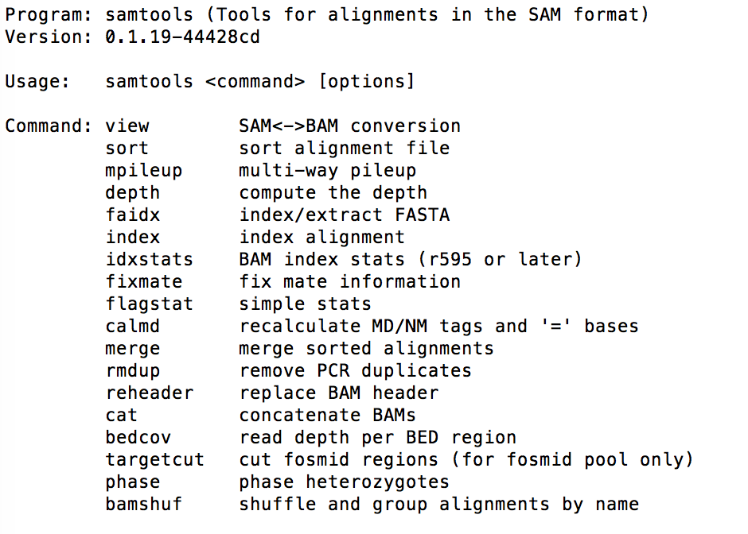
Samtools
Tools for
converting SAM <-> BAM
Viewing BAM files (eg. samtools view file.bam | less )
Sorting BAM files, and lots more:

Slide 30
Visualizing Alignments of RNA-Seq reads

Slide 31
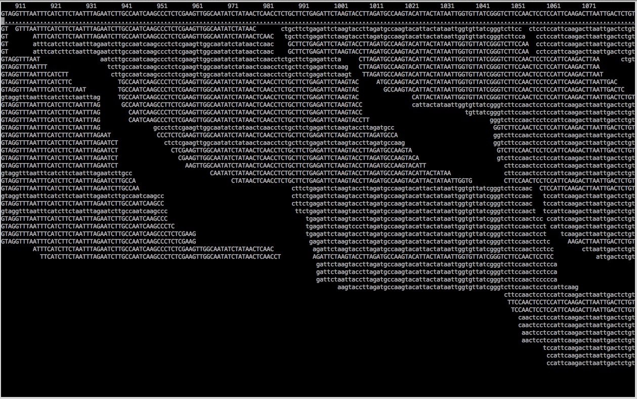
Text-based Alignment Viewer
% samtools tview alignments.bam target.fasta

Slide 32
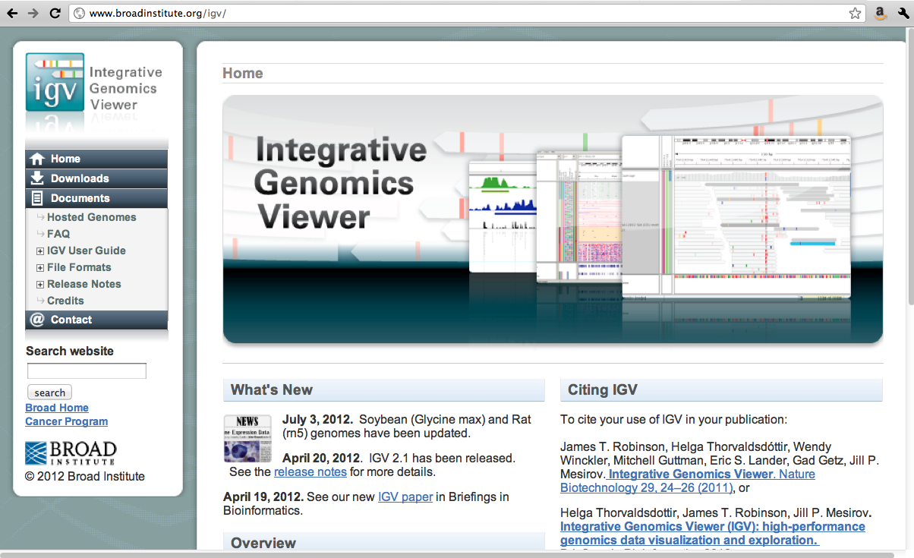
IGV

Slide 33
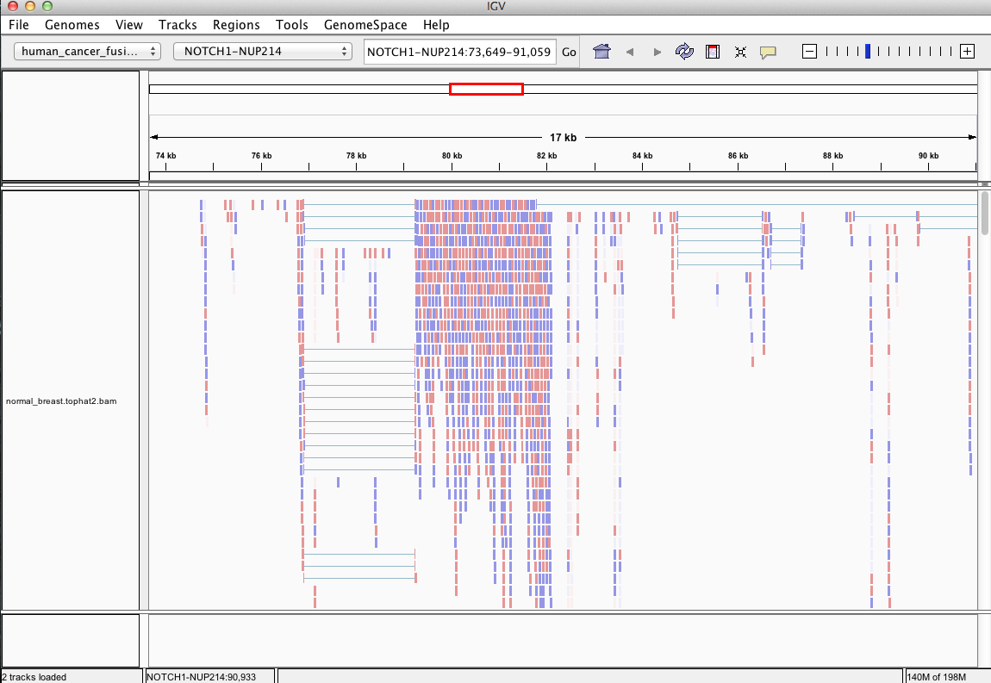
IGV: Viewing Tophat Alignments

Slide 34
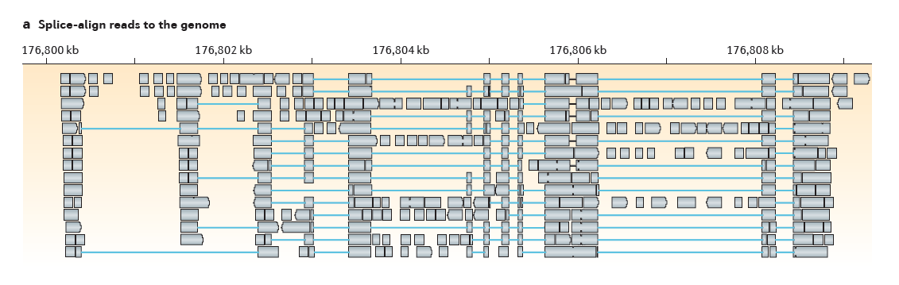
Transcript Reconstruction Using Cufflinks
From Martin & Wang. Nature Reviews in Genetics. 2011

Slide 35
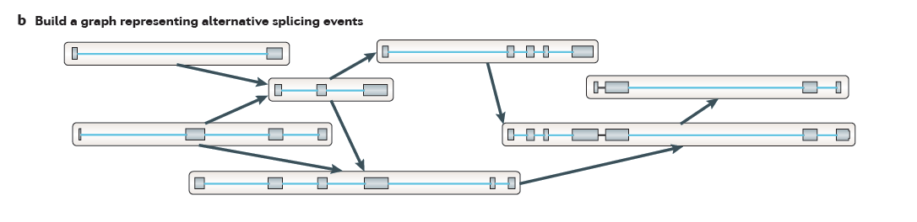
Transcript Reconstruction Using Cufflinks
From Martin & Wang. Nature Reviews in Genetics. 2011

Slide 36
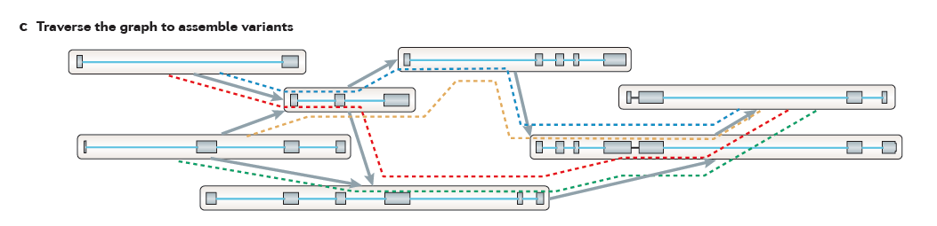
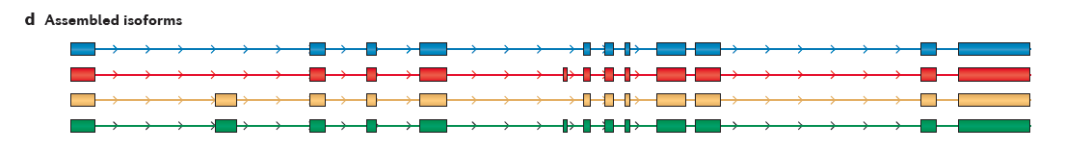
Transcript Reconstruction Using Cufflinks
From Martin & Wang. Nature Reviews in Genetics. 2011

Slide 37
Transcript Structures in GTF Format (tab-delimited fields per line shown transposed to a column format here)
(genomic contig identifier)
0 chr1
1 Cufflinks
2 transcript
3 101
4 5716
5 1000
6 +
7 .
8 gene_id "CUFF.1"; transcript_id "CUFF.1.1"; FPKM "378.0239937260“
0 chr1
1 Cufflinks
2 exon
3 101
4 5716
5 1000
6 +
7 .
8 gene_id "CUFF.1"; transcript_id "CUFF.1.1"; exon_number "1"; FPKM "378.0239937260“
(left coordinate)
(right coordinate)
(strand)
(annotations)

Slide 38
Demo: Tuxedo and IGV
https://github.com/trinityrnaseq/RNASeq_Trinity_Tuxedo_Workshop/wiki/Tuxedo-Genome-Guided-Transcriptome-Assembly-Workshop
Run Tophat to align reads to the genome
Reconstruct transcripts using cufflinks
View genome-aligned reads and reconstructed transcripts using IGV

Slide 39
De novo transcriptome assembly
No genome required
Empower studies of non-model organisms
expressed gene content
transcript abundance
differential expression

Slide 40
The General Approach to De novo RNA-Seq Assembly Using De Bruijn Graphs
Notes:
In these next sections, I’ll provide an overview of the Trinity assembly algorithm.
It’s not necessary to understand all the details of the Trinity algorithm in order to effectively use the software. If you want to, you can think of it as a black box with read sequences as input and assembled transcript contigs as output, but it is useful to understand what is happening at the various stages of the assembly when monitoring its execution or trying to troubleshoot various aspects of its behavior.

Slide 41
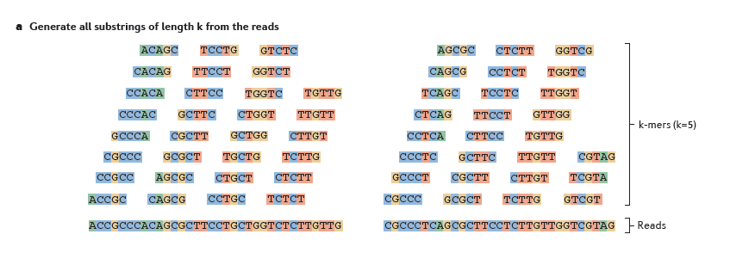
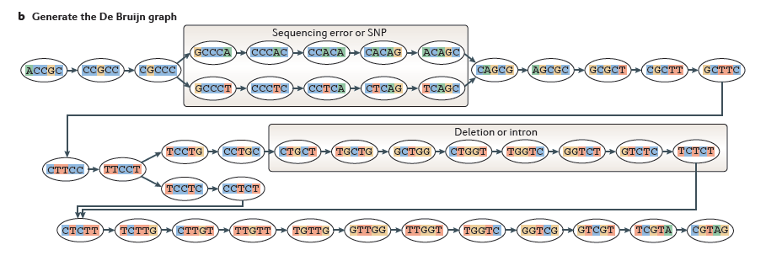
Sequence Assembly via De Bruijn Graphs
From Martin & Wang, Nat. Rev. Genet. 2011
Notes:
The first step in a de Bruijn graph-based assembly is to construct the de Bruijn graph from the sequence reads.
Each read is decomposed into substrings of some specified length k. Each word of length k is called a k-mer. In this example, k is set to 5, so here each 5-mer is extracted from the read. An ordered list of k-mers is generated by scanning a window of length k across the length of the read. You’ll notice that each k-mer overlaps the next k-mer by exactly k-1 bases.
--
Then, a de Bruijn graph is constructed by assigning each unique k-mer as a node in the graph and connecting immediately overlapping k-mers by an edge. This is a very effective and compact way of representing the sequence data within the reads. For example, hundreds of millions of reads can be sequenced, and the identical sequence regions within reads become compressed into individual nodes within the graph.
At positions where related sequences diverge due to allelic polymorphisms, splicing variations, repeats, or due to sequencing errors, the graph will branch and can form bulges or loops.

Slide 42
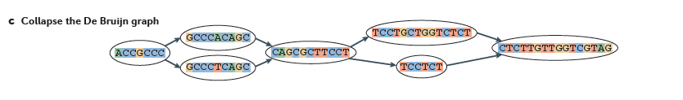
From Martin & Wang, Nat. Rev. Genet. 2011
Notes:
After building the graph from all the reads, the graph is typically pruned to remove bubbles and structures that likely stem from sequencing errors,
--
and the graph is compacted by collapsing those nodes that form linear unbranched chains of overlapping k-mers.
--
For example, this linear chain of kmers is compressed into a single node in the compacted graph.

Slide 43
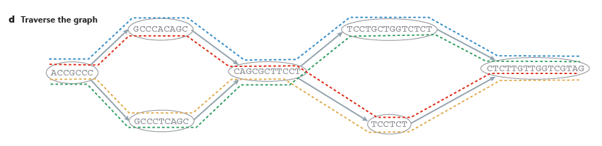
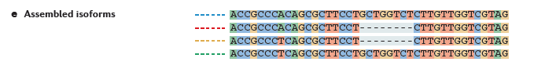
From Martin & Wang, Nat. Rev. Genet. 2011
Notes:
Now, to reconstruct transcripts, paths are traversed across the graph.
--
In this example, there are four possible paths from the beginning to the end of the graph, each path shown traced by a different color.
By traversing each path, a different transcript sequence is generated.
--
In this case, each of the four differently colored paths generates a different sequence as shown.
By taking into account the paths that the reads trace through the graph, along with any mate-pairing information, constraints can be placed such that not all possible path combinations are reported, but instead only those paths that are best supported by the RNA-seq reads.

Slide 44

Contrasting Genome and Transcriptome Assembly
Genome Assembly
Transcriptome Assembly
Uniform coverage
Single contig per locus
Double-stranded
Exponentially distributed coverage levels
Multiple contigs per locus (alt splicing)
Strand-specific
Notes:
Both genome and transcriptome assemblers leverage the de Bruijn graph structure, but are tuned to assemble reads according to very different expected characteristics. This is why you wouldn’t want to leverage a genome assembler for transcriptome assembly and vice-versa, since each method is highly specialized.
Some of the key differences between genome and transcriptome assemblers include the following:
--
Genome assemblers expect that read coverage is going to be rather uniform and will often discard sequences that occur at high coverage as repetitive sequences. Transcriptome assembly needs to consider a wide range of coverage levels spanning several orders of magnitude since sequences with high coverage are more likely to represent highly expressed transcripts instead of repeats.
--
Genome assemblers aim to generate a single contig per locus, possibly two if tuned to separate haplotypes in a polymorphic genome assembly. In transcriptome assembly, it’s understood that single genes can generate many alternatively spliced transcripts, and multiple contigs are reported per locus where evidence of transcript complexity exists.
--
Finally, in genome assembly, reads are assumed to be derived from either strand of the double-stranded DNA molecule. Given strand-specific RNA-Seq reads, Transcriptome assemblers should aim to assemble sense and antisense transcripts separately.
--
Trinity, of course, was developed to take all of these properties into account.

Slide 45
Trinity Aggregates Isolated Transcript Graphs
Genome Assembly
Single Massive Graph
Trinity Transcriptome Assembly
Many Thousands of Small Graphs
Entire chromosomes represented.
Ideally, one graph per expressed gene.
Notes:
A significant difference between Trinity as compared to all other assemblers is how it goes about building the graphs.
Genome assemblers (and other transcriptome assemblers that are built on top of genome assemblers) typically build single large graphs.
Trinity instead tries to partition the data into many thousands of small graphs, ideally one graph per expressed gene. This is possible because most expressed transcripts tend to be non-overlapping.
Having many small graphs lends itself to massive parallel processing, which is an added computational benefit.

Slide 46
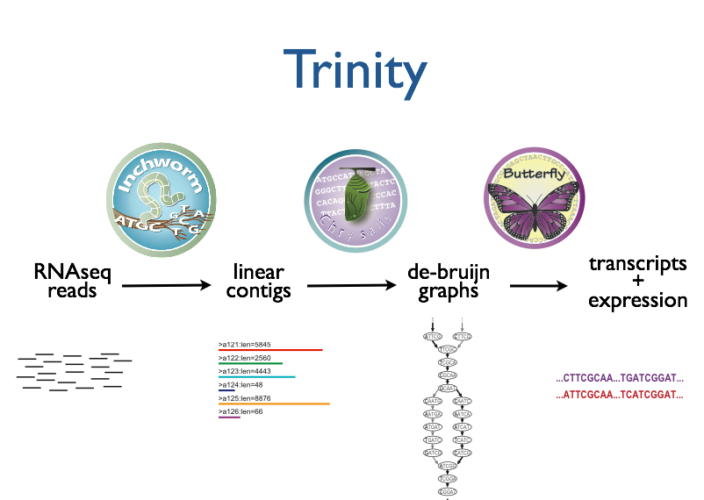



Trinity – How it works:
RNA-Seq reads
Linear
contigs
de-Bruijn
graphs
Transcripts
+
Isoforms
Thousands of disjoint graphs
Notes:
Here’s a high-level overview of the whole Trinity assembly algorithm.
We call it Trinity because it involves three major steps that we’ve built into three separate software modules.
It starts with Inchworm, which first assembles the RNA-Seq data into linear contigs.
Then, Chrysalis groups contigs that are related due to alternative splicing or gene duplication and constructs de bruijn graphs.
Finally, Butterfly examines reads in the context of the de bruijn graphs, and reports the final full-length transcripts and isoforms of transcripts.

Slide 47
Inchworm Algorithm
Decompose all reads into overlapping Kmers (25-mers)
Identify seed kmer as most abundant Kmer, ignoring low-complexity kmers.
Extend kmer at 3’ end, guided by coverage.
G
A
GATTACA
9
T
C
Notes:
The inchworm algorithm works as follows:
It first decomposes reads into a catalog of overlapping Kmers. By default we use overlapping 25-mers. This is similar to the first step of generating a de Bruijn graph, but we don’t actually build a de Bruijn graph. We just store the k-mers and their frequency in all the reads, and don’t store the edges between k-mers. This is done mainly to save on the amount of memory and computation required.
The single most abundant kmer with reasonable sequence complexity is identified as a seed kmer.
This seed kmer is then extended at the 3’ end guided by the coverage of overlapping kmers.
For each extension, there are four possible kmers, each ending with one of the four possible nucleotides.

Slide 48
Inchworm Algorithm
G
4
A
GATTACA
9
T
C
Notes:
Each of the possible overlapping kmers is looked up in the kmer catalog to determine their frequency within the reads.
In this toy example, the kmer ending with ‘G’ is found 4 times.

Slide 49
Inchworm Algorithm
G
4
A
GATTACA
1
9
T
C
Notes:
‘A’ is found once.

Slide 50
Inchworm Algorithm
G
4
A
GATTACA
1
9
T
0
C
Notes:
The kmer ending with ‘T’ doesn’t exist in the reads, so it has a count of zero.

Slide 51
Inchworm Algorithm
G
4
A
GATTACA
1
9
T
0
C
4
Notes:
And the kmer ending with ‘C’ is found 4 times.

Slide 52
Inchworm Algorithm
G
4
A
GATTACA
1
9
T
0
C
4
Notes:
In this case we have a tie.

Slide 53
Inchworm Algorithm
G
A
0
5
T
1
G
4
C
A
0
GATTACA
1
9
T
0
G
C
1
4
A
1
C
T
1
1
Notes:
When we encounter a tie, we explore the tied paths recursively to find that extension that provides the highest cumulative coverage.

Slide 54
Inchworm Algorithm
G
A
0
5
T
1
G
4
C
A
0
GATTACA
1
9
T
0
G
C
1
4
A
1
C
T
1
1
Notes:
In this case, the extension of two overlapping kmers ending with an ‘A’ provides the highest cumulative coverage, and so the other paths are ignored.

Slide 55
Inchworm Algorithm
A
5
G
4
GATTACA
9
Notes:
Extensions continue to occur in this way until there are no more kmers that provide for an extension.

Slide 56
Inchworm Algorithm
A
5
C
G
0
4
T
0
GATTACA
A
9
6
G
1
Notes:
Then, we extend from right to left in the same manner, following the path of greatest coverage.

Slide 57
Inchworm Algorithm
A
5
G
4
GATTACA
A
9
6
A
7
Report contig: ….AAGATTACAGA….
Remove assembled kmers from catalog, then repeat the entire process.
Notes:
Once the extension completes, the assembled contig is reported.
--transition—
The kmers found in the contig are removed from the kmer catalog, and the entire process is repeated starting from a new seed. The Inchworm assembly ends when the entire k-mer catalog has been depleted.

Slide 58
Inchworm Contigs from Alt-Spliced Transcripts
Expressed isoforms
Isoform A
Isoform B
Notes:
Inchworm alone performs well at reconstructing full-length transcripts, but in the case of alternative splicing, inchworm alone is unable to reconstruct full-length transcripts for each of the isoforms.
This is because it assembles contigs from unique kmers and the sequences shared between isoforms can be reported in only one Inchworm contig.
For example, here are two expressed isoforms which share the orange and green sequence regions in common, and Isoform A has a stretch of unique sequence shown in yellow, such as coming from an exon skipped in isoform B.

Slide 59

Inchworm Contigs from Alt-Spliced Transcripts
Expressed isoforms
Expression
Isoform A
(low)
Isoform B
(high)
Graphical representation
Notes:
This can be represented graphically like so. Based on the read support, we find that Isoform B is highly expressed as compared to Isoform A, and we indicate that in the graph by the thicker edge.

Slide 60
Inchworm Contigs from Alt-Spliced Transcripts
Notes:
When Inchworm greedily assembles k-mers, it will often report the more highly expressed isoform as a single full-length contig.

Slide 61
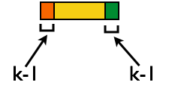
Inchworm Contigs from Alt-Spliced Transcripts
+
No k-mers in common
Notes:
And only the unique regions of alternatively spliced isoforms are reported as separate contigs.
Again, these contigs share no k-mers in common.
The remaining components of Trinity are responsible for linking these related contigs together and reporting more complete sequences for each. This is where Chrysalis first comes in.

Slide 62
Inchworm Contigs from Alt-Spliced Transcripts
+
Notes:
Although these inchworm contigs lack complete kmers in common, they maintain partial kmer overlap at points where the isoforms diverge.
The smaller contig can still be associated with the larger contig based on these partial kmers of length k-1, and we can find reads to support the junction.

Slide 63
Chrysalis Re-groups Related Inchworm Contigs
+
Chrysalis uses (k-1) overlaps and read support to link related Inchworm contigs
Notes:
The Chrysalis tool, in the next step, exploits these partial kmers to regroup related contigs. If reads exist that support the junction at the k-1 overlaps, then Chrysalis will cluster the inchworm contigs together.

Slide 64
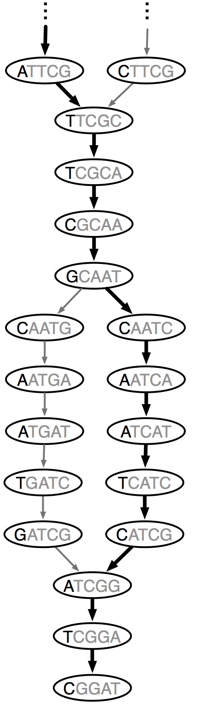
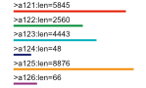
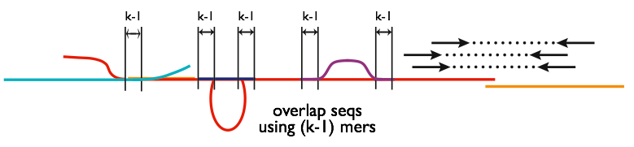
Chrysalis
Integrate isoforms
via k-1 overlaps
Build de Bruijn Graphs
(ideally, one per gene)
Notes:
Here is a high-level overview of the Chrysalis operations.
Chrysalis clusters related contigs based on these k-1mer overlaps.
Chyrsalis also leverages read pairing information to join minimally overlapping contigs.
--
After identifying the connected inchworm contigs, it constructs a separate de Bruijn graph for each group.
(Again, the de Bruijn graph represents the overlaps between adjacent kmers in the sequences with branches at sites of variation.)

Slide 65
Thousands of Chrysalis Clusters
Notes:
And this is how we end up with many separate graphs, ideally one graph per gene, with each graph representing the transcriptional complexity at that locus.
These graphs can then be processed in a parallel fashion by the next step of Trinity involving Butterfly.

Slide 66
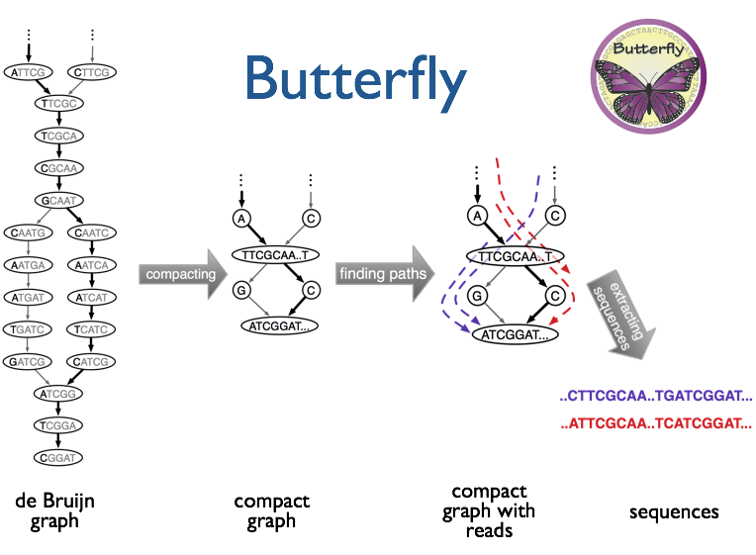
(isoforms and paralogs)
Notes:
Butterfly operates on each of these graphs independently.
It first compacts the de Bruijn graph by collapsing the unbranched stretches, as described earlier.
It then threads the original sequencing reads into the graph, tracking the paths occupied by the reads and those paths supported by mate pairs.
Butterfly then reports the most probable paths through the graph supported by the reads and read pairings, emitting full-length transcripts for isoforms and paralogs.

Slide 67
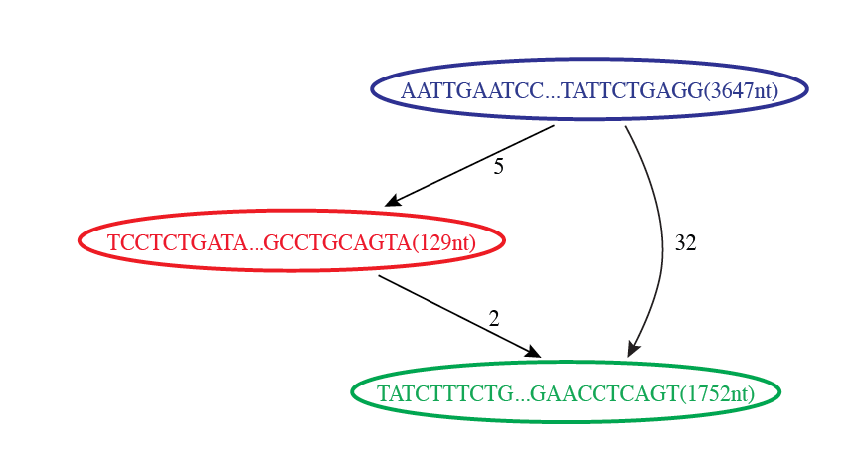

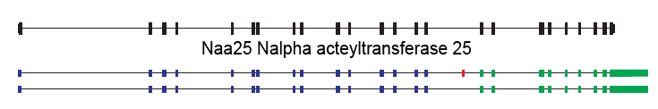
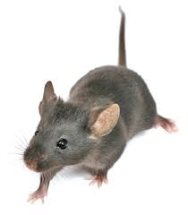
Butterfly Example 1: Reconstruction of Alternatively Spliced Transcripts
Butterfly’s Compacted Sequence Graph
Reconstructed Transcripts
Aligned to Mouse Genome
Notes:
Here’s a real example to demonstrate how this works in practice.
In our mouse RNA-Seq data set, we find a compacted de Bruijn graph that has three nodes.

Slide 68
Reconstruction of Alternatively Spliced Transcripts
Butterfly’s Compacted Sequence Graph
Reconstructed Transcripts
Aligned to Mouse Genome
Notes:
By traversing the path from the top blue node to the bottom green node, we generate a single transcript sequence.

Slide 69
Reconstruction of Alternatively Spliced Transcripts
Butterfly’s Compacted Sequence Graph
Reconstructed Transcripts
Aligned to Mouse Genome
Notes:
By traversing the alternative path through the red node, we generate another transcript sequence. This second transcript shares the blue and green segments, but contains an additional internal red segment.

Slide 70
Reconstruction of Alternatively Spliced Transcripts
Butterfly’s Compacted Sequence Graph
Reconstructed Transcripts
Aligned to Mouse Genome
(Reference structure)
Notes:
From mapping the transcripts to the reference genome sequence we can see that the inserted sequence actually corresponds to a cassette exon that is alternatively spliced, and novel given that it wasn’t found in the reference transcript structure.

Slide 71
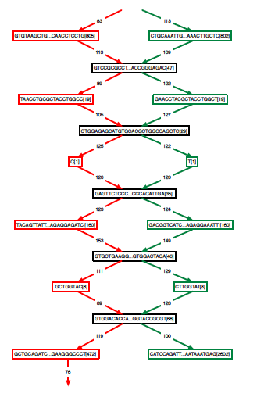
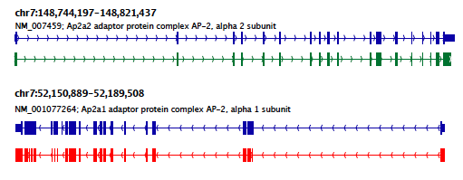
Teasing Apart Transcripts of Paralogous Genes
Butterfly Example 2:
Ap2a1
Ap2a2
Notes:
Some transcript graphs are far more complex.
Here we have an example of two such transcripts derived from paralogous genes that became intertwined in the compacted graph due to stretches of sequence identity among segments of the transcripts.
Shared sequences are represented by the central sequence nodes and paralog-specific sequences are represented by branched nodes.
By tracing consistent paths of reads through the graph, Butterfly is able to tease apart the paralogous gene sequences and report the individual transcripts. In this case, the green path yields one of the transcripts and the red path yields the other.

Slide 72
Teasing Apart Transcripts of Paralogous Genes
Ap2a1
Ap2a2
Notes:
These transcripts, when mapped to the mouse genome match perfectly with the reference gene structures. Here, the reference structures are shown in blue, and the Trinity-reconstructed transcripts are shown below.

Slide 73
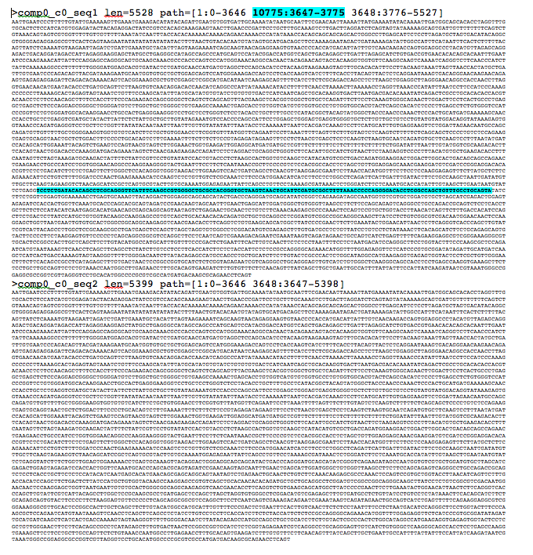
Trinity output: A multi-fasta file

Slide 74
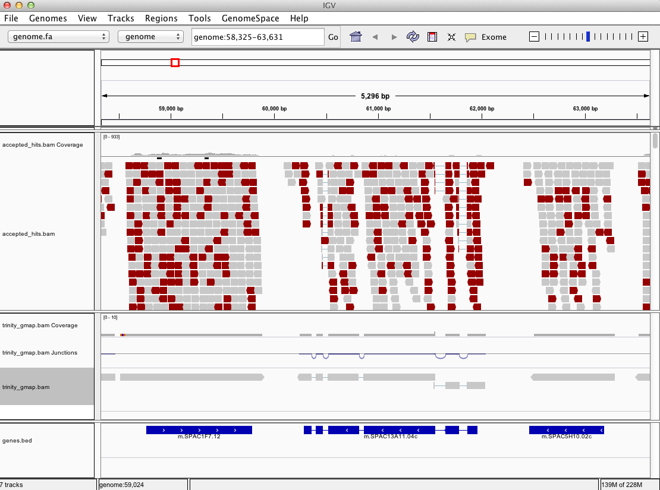
Can align Trinity transcripts to genome scaffolds to examine intron/exon structures
(Trinity transcripts aligned using GMAP)

Slide 75
Trinity Demo
https://github.com/trinityrnaseq/RNASeq_Trinity_Tuxedo_Workshop/wiki/Trinity-De-novo-Transcriptome-Assembly-Workshop
Assemble RNA-Seq using Trinity
Examine Trinity in context of a genome:
Align Trinity transcripts to the genome using GMAP
Align rna-seq reads to genome using Tophat
Visualize all alignments using IGV

Slide 76
Improved reconstruction with deeper sequencing depth and Genome-based reconstruction is more sensitive than de novo methods
# Genes w/ fully reconstructed transcripts
Mouse data
Million PE reads
Notes:
Regardless of the strategy chosen, the sensitivity for full-length transcript reconstruction will be effected by the depth of sequencing.
Here is a plot showing the number of genes having fully reconstructed transcripts as a function of depth of sequencing for both methods.
You can see that both methods generate more full-length transcripts with increased depth of sequencing, and both begin to saturate beyond a certain sequencing depth.
You’ll also notice that the cufflinks (genome-based) approach has increased sensitivity as compared to Trinity de novo assembly. This is because the genome-based method requires less overlap among reads, and is able to use the genome to fill in gaps between alignments of PE reads.

Slide 77
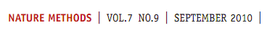
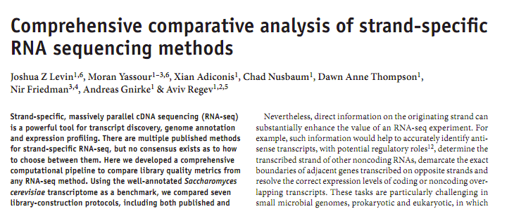
Strand-specific RNA-Seq is Preferred
Computationally: fewer confounding graph structures in de novo assembly:
ex. Forward != reverse complement
(GGAA != TTCC)
Biologically: separate sense vs. antisense transcription
‘dUTP second strand marking’ identified as the leading protocol
Notes:
Although Trinity doesn’t absolutely require it, Strand specific rna-seq is the preferred substrate for transcriptome assembly.
Computationally, there are fewer confounding graph structures since forward kmers and the reverse complement kmers are treated as distinct.
Biologically, it’s important because it allows for the separation of sense and antisense transcription.
--
Our group at the Broad performed a study of the various methods for generating strand-specific RNA-Seq,
--
and we found the ‘dUTP second strand marking’ method to be the leading protocol.
We routinely generate strand-specific RNA-Seq as our default protocol at the Broad, and there are now kits available that make the approach readily accessible.

Slide 78
dUTP 2nd Strand Method: Our Favorite
RNA
First-strand synthesis with normal dNTPs
cDNA
Second-strand synthesis with dTTP → dUTP
U
U
UU
U
UU
Adaptor ligation
U
U
UU
U
UU
U
U
UU
U
UU
USER™
(Uracil-Specific Excision Reagent)
Remove “U”s
PCR and paired-end sequencing
Modified from Parkhomchuk et al. (2009) Nucleic Acids Res. 37:e123
Slide courtesy of Joshua Levin, Broad Institute.

Slide 79
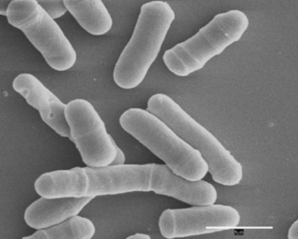
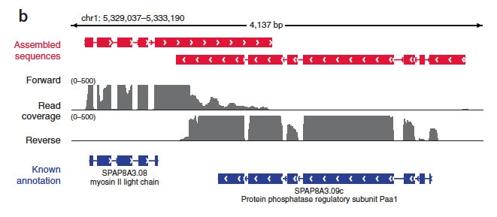
Overlapping UTRs from Opposite Strands
Schizosacharomyces pombe
(fission yeast)
Notes:
Strand-specific RNA-Seq is tremendously useful when applied to organisms that have compact genomes.
Here’s an example from Schizosaccharomyces pombe (fission yeast) where we have two known genes that are transcribed on opposite strands and point toward each other.
We have strand specific rna-seq and the coverage plots for each strand are shown above. From the coverage plots, you can see that there’s overlap in the coverage in their UTR regions, and if we didn’t have strand-specific data, then we’d reconstruct a single transcript that covers both genes. Because we have the strand-specific data, though, Trinity is able to separately reconstruct these transcripts, allowing for overlap among their UTRs.

Slide 80

Antisense-dominated Transcription
Notes:
Here’s another example in fission yeast that highlights the importance of strand-specific rna-seq.
This region of the genome encodes three genes that are all encoded on the same strand. From the rna-seq coverage plots, we can see that the two genes on the end are transcribed on their coding strand, but the central gene encoding a meiosis specific protein kinase is dominated by transcription on the opposite strand. This antisense transcription is thought to play an important role in the regulation of meiotic genes in fission yeast, and would have gone unnoticed if we hadn’t used strand-specific rna-seq.

Slide 81
Summary
Two paradigms for transcript reconstruction
Rna-seq alignment assembly
Tuxedo (tophat, cufflinks)
genome-free de novo read assembly
Trinity
Often best to pursue both strategies
Maximize sensitivity for genome-based transcript reconstruction + capture missing or ill-represented transcripts via de novo assembly.

Slide 82
Abundance Estimation (Aka. Computing Expression Values)

Slide 83

Expression Value
Slide courtesy of Cole Trapnell
Notes:
In RNA-Seq, the expression of a transcript is measured based on the number of RNA-Seq reads sampled that map to the corresponding transcript.
The number of reads sequenced for a transcript depends on a number of factors.
For one, the number of reads observed depends on the expression of the transcript. Transcripts that are expressed at higher levels should account for more reads in the sample than those expressed at lower levels if all else is equal.
Also, the sequencing depth must be taken into account. The deeper you sequence, the more reads you’ll observe mapping to transcripts at any expression level.

Slide 84
Expression Value
Slide courtesy of Cole Trapnell
Notes:
The number of reads corresponding to a transcript also depends on its length. Longer transcripts represent more real estate in the sequencing library than shorter transcripts expressed at the same level (number of transcripts per cell).

Slide 85
Normalized Expression Values
Transcript-mapped read counts are normalized for both length of the transcript and total depth of sequencing.
Reported as: Number of RNA-Seq Fragments Per Kilobase of transcript per total Million fragments mapped
FPKM
Notes:
And so, when computing expression for transcripts, both the number of reads mapping to each transcript and the lengths of those transcripts must be taken into account.
The metric reported is often in units of FPKM.

Slide 86
Transcripts per Million (TPM)
Preferred metric for measuring expression
Better reflects transcript concentration in the sample.
Nicely sums to 1 million
Linear relationship between TPM and FPKM values.
TPM
Both are valid metrics, but best to be consistent.
FPKM

Slide 87

Multiply-mapped Reads Confound Abundance Estimation
Isoform A
EM
Isoform B
Blue = multiply-mapped reads
Red, Yellow = uniquely-mapped reads
Notes:
Accurately estimating transcript expression levels is actually much more complicated due to the fact that not all RNA-Seq reads are able to map uniquely to their corresponding transcript.
This is particularly the case for alternatively spliced transcripts. Such transcripts are not entirely identical, but can share a substantial amount of sequence in common, differing at sites of splicing variation, such as due to skipped exons or from differential splice site selection.
Here’s an example of the problem, where we have two isoforms A, B, with shared sequences in blue and isoform- unique sequences in yellow or red. Reads mapping to either the yellow or red sequences will map uniquely and unambiguously. However, the reads that map to the blue regions will map ambiguously. It isn’t obvious as to which transcript the reads were derived. Using sophisticated statistical inference methods, we can infer the likelihood of a blue read having been derived from one isoform or the other, by taking into account the number of uniquely mapping reads and the length of each isoform.

Slide 88
Multiply-mapped Reads Confound Abundance Estimation
Isoform A
EM
Isoform B
Use Expectation Maximization (EM) to find the most likely assignment of reads to transcripts.
Performed by:
RSEM, eXpress, kallisto, salmon, …
Blue = multiply-mapped reads
Red, Yellow = uniquely-mapped reads
New fast alignment-free methods now available! eg. Kallisto
Notes:
There are tools available that implement these methods, which rely on the technique of expectation maximization.
Expectation maximization involves cycling between estimating parameters of a statistical model based on the data, and computing likelihood estimates of results from applying those model parameters.
In this case, you can think of the algorithm as fractionally assigning the blue reads to each isoform and estimating the likelihood of those assignments. With each iteration of the algorithm, the read assignments become more likely, and eventually the likelihood will converge to a maximum value. Finally, the counts of reads assigned to each isoform are reported.

Slide 89

Fast Abundance Estimation Using Pseudo-alignments and Equivalence Classes (Kallisto software, Bray et al., NBT 2016)
Adapted from Fig 1 from Bray et al.

Slide 90
Differential Expression Analysis Using RNA-Seq
Notes:
Differential expression analysis in RNA-Seq involves comparing expression levels for genes across two or more different samples.
It is mostly an exercise in counting reads and doing statistics to determine if the counts are significantly different between conditions.

Slide 91
Why cross-sample normalization is important
Absolute RNA quantities per cell
Measured relative abundance via RNA-Seq
Cross-sample normalized (rescaled) relative abundance
Liver
Kidney
Liver
Kidney
Liver
Kidney
eg. Some housekeeping gene’s expression level:
Expression
Relative Experssion
Re-Scaled Relative Expression
L
K
L
K
L
K

Slide 92

Normalization Required Otherwise, housekeeping genes look diff expressed due to sample composition differences
Subset of genes highly expressed in liver
Technical replicates
Liver - kidney
Robinson and Oshlack, Genome Biology, 2010
Notes:
Pushes relative concentration of the other liver transcripts down.

Slide 93

Normalization methods for Illumina high-throughput RNA sequencing data analysis.
From “A comprehensive evaluation of normalization methods for Illumina high throughput RNA sequencing data analysis” Brief Bioinform. 2013 Nov;14(6):671-83
http://www.ncbi.nlm.nih.gov/pubmed/22988256

Slide 94

Differential Expression Analysis

Slide 95
Diff. Expression Analysis Involves
Counting reads
Statistical significance testing
Sample_A
Sample_B
Fold_Change
Significant?
Gene A
1
2
2-fold
No
Gene B
100
200
2-fold
Yes

Slide 96

Observed RNA-Seq Counts Result from Random Sampling of the Population of Reads
Technical variation in RNA-Seq counts per feature is well modeled by the Poisson distribution
Mean # fragments
(observed read counts)
See: http://en.wikipedia.org/wiki/Poisson_distribution
Notes:
When we count reads, what we’re really doing is randomly sampling reads from a population.
Observed counts resulting from random sampling are well modeled by the Poisson distribution.
It has been shown that technical replicates of rna-seq samples, where it’s the same sample (which should show no differentially expressed transcripts), yield distributions of counts that are well modeled by Poisson.

Slide 97


Example: One gene*not* differentially expressed
SampleA(gene) = SampleB(gene) = 4 reads
Distribution of observed counts for single gene (under Poisson model)
Dist. of log₂(fold change) values
same
SampleA(geneX)
SampleB(geneX)
2-fold diff
density
density
4-fold diff
(k) number of reads observed
x = log₂(SampleA/SampleB)

Slide 98

Beware of concluding fold change from small numbers of counts
Poisson distributions for counts based on 2-fold expression differences
No confidence in 2-fold difference. Likely observed by chance.
High confidence in 2-fold difference. Unlikely observed by chance.
P(x=k)
Observed Read Count (k)
From: http://gkno2.tumblr.com/post/24629975632/thinking-about-rna-seq-experimental-design-for
Notes:
Can’t deduce with confidence that the transcripts are two-fold differentially expressed based on the distribution of observed counts. Sequence deeper.
Poisson noise limits the ability to confidently detect differential expression with small values of read counts.

Slide 99
More Counts = More Statistical Power
Example: 5000 total reads per sample.
Observed 2-fold differences in read counts.
SampleA
Sample B
Fisher’s Exact Test
(P-value)
geneA
1
2
1.00
geneB
10
20
0.098
geneC
100
200
< 0.001

Slide 100


Tools for DE analysis with RNA-Seq
edgeR
ShrinkSeq DESeq
baySeq
Vsf
Limma/Voom
mmdiff
cuffdiff
ROTS
TSPM
DESeq2
EBSeq
NBPSeq
SAMseq
NoiSeq
(italicized not in R/Bioconductor
but stand-alone)
See: http://www.biomedcentral.com/1471-2105/14/91
A comparison of methods for differential expression analysis of RNA-seq data
Soneson & Delorenzi, 2013

Slide 101
Typical output from DE analysis
logFC logCPM PValue FDR
TRINITY_DN876_c0_g1_i1 -7.15049572793027 10.6197708379285 0 0
TRINITY_DN6470_c0_g1_i1 -7.26777912190146 7.03987604865422 1.687485656951e-287 6.46813252309319e-284
TRINITY_DN5186_c0_g1_i1 -7.85623682454322 9.18570464327063 1.17049180235068e-278 2.99099671894011e-275
TRINITY_DN768_c0_g1_i1 7.72884741150304 9.7514619195169 4.32504881419265e-272 8.28895605240022e-269
TRINITY_DN70_c0_g1_i1 -12.7646078189688 7.86482982471445 3.92853491279431e-253 6.02322972829624e-250
TRINITY_DN1587_c0_g1_i1 -5.89392061881667 9.07366563894607 6.32919557933429e-243 8.08660221852944e-240
TRINITY_DN3236_c0_g1_i1 -7.27029815068473 8.02209568234202 3.64955175271959e-235 3.99678053376405e-232
TRINITY_DN4631_c0_g1_i1 -7.45310693639574 6.91664918183241 4.30540921272851e-229 4.1256583780971e-226
TRINITY_DN5082_c0_g5_i1 -5.33154406167545 10.6977538760467 2.74243356676259e-225 2.33594396920022e-222
TRINITY_DN1789_c0_g3_i1 10.2032564835076 7.32607652700285 1.44273728647186e-213 1.10600240380933e-210
TRINITY_DN4204_c0_g1_i1 4.81030233739325 9.88844409410644 9.27180216086162e-205 6.46160321501501e-202
TRINITY_DN799_c0_g1_i1 -4.22044475626154 6.9937398638711 1.24746518421083e-197 7.96922341846683e-195
TRINITY_DN196_c0_g2_i1 4.60597918494257 9.86878463857276 1.9819997623131e-192 1.16877001368402e-189
TRINITY_DN5041_c0_g1_i1 -4.27126549355785 9.70894399883 1.8930437900069e-185 1.03657669244235e-182
TRINITY_DN1619_c0_g1_i1 -4.47156415953777 9.22535948721718 1.76766063029526e-181 9.03392426122899e-179
TRINITY_DN899_c0_g1_i1 -4.90914328409143 7.93768691394594 1.11054513767547e-180 5.32089939088761e-178
TRINITY_DN324_c0_g2_i1 4.87160837667488 6.84850312231775 2.20092562166991e-179 9.92487989160089e-177
TRINITY_DN3241_c0_g1_i1 -4.77760618069256 7.94111259715689 1.60585457735621e-173 6.83915621667372e-171
TRINITY_DN4379_c0_g1_i1 3.85133572453294 7.23712813663389 3.48140532848425e-164 1.4046554341137e-161
TRINITY_DN1919_c0_g1_i1 4.05998814332136 6.95937301668582 1.8588621194715e-161 7.12501850393425e-159
TRINITY_DN2504_c0_g1_i1 -6.92417817059644 6.20370039359785 2.42022459856956e-160 8.83497227268296e-158
…
Up vs. Down regulated
Avg. expression level
Significance

Slide 102
Visualization of DE results and Expression Profiling

Slide 103


Plotting Pairwise Differential Expression Data
Volcano plot
( fold change vs. significance)
MA plot
(abundance vs. fold change)
Log₁₀ (FDR)
Log₂ (fold change) (M of MA)
Log₂ (fold change)
Log₂ Average Expression level (A of MA)
Significantly differently expressed transcripts have FDR <= 0.001
(shown in red)

Slide 104

Comparing Multiple Samples
Heatmaps provide an effective tool for navigating differential expression across multiple samples.
Clustering can be performed across both axes:
-cluster transcripts with similar expression patters.
-cluster samples according to similar expression values among transcripts.

Slide 105

Examining Patterns of Expression Across Samples
Can extract clusters of transcripts and examine them separately.

Slide 106
RNA-Seq Analysis Frameworks

Slide 107


Tuxedo Framework for Transcriptome Analysis
Derived from: Nat Protoc. 2012 Mar 1;7(3):562-78. doi: 10.1038/nprot.2012.016.

Slide 108



Notes:
Last year, we published a paper in Nature Protocols that outlines how you would perform a Trinity de novo assembly followed by supported downstream analyses including abundance estimation, differential expression analysis, and exploring patterns of transcript expression across multiple sample types.

Slide 109
Summary of Key Points
RNA-Seq is a versatile method for transcriptome analysis enabling quantification and novel transcript discovery.
Genome-based and genome-free methods exist for transcript reconstruction
Expression quantification is based on sampling and counting reads derived from transcripts
Fold changes based on few read counts lack statistical significance.
Multiple analysis frameworks are available – alternative and often complementary approaches to support biological investigations.

Slide 110
Papers of Interest
Next generation transcriptome assembly
http://www.nature.com/nrg/journal/v12/n10/full/nrg3068.html
Tuxedo protocol
http://www.ncbi.nlm.nih.gov/pmc/articles/PMC3334321/
Trinity
http://www.ncbi.nlm.nih.gov/pmc/articles/PMC3571712/
http://www.nature.com/nprot/journal/v8/n8/full/nprot.2013.084.html

